Slide 1

INTRODUCTION TO PYTHON PROGRAMMING LANGUAGE
Friday 15th May 2026
DEVELOPMENT OF A RESTAURANT WEB APP
Lecturer:
Mr Mbieuteu Amos
By:
KAMDEM MATCHUM JUDITH
MVONDO MVONDO ANTHONY
MASSADO DJOKO AICHA
MEP MEKU AUDREY
IBRAHIM DIALLO

Slide 2
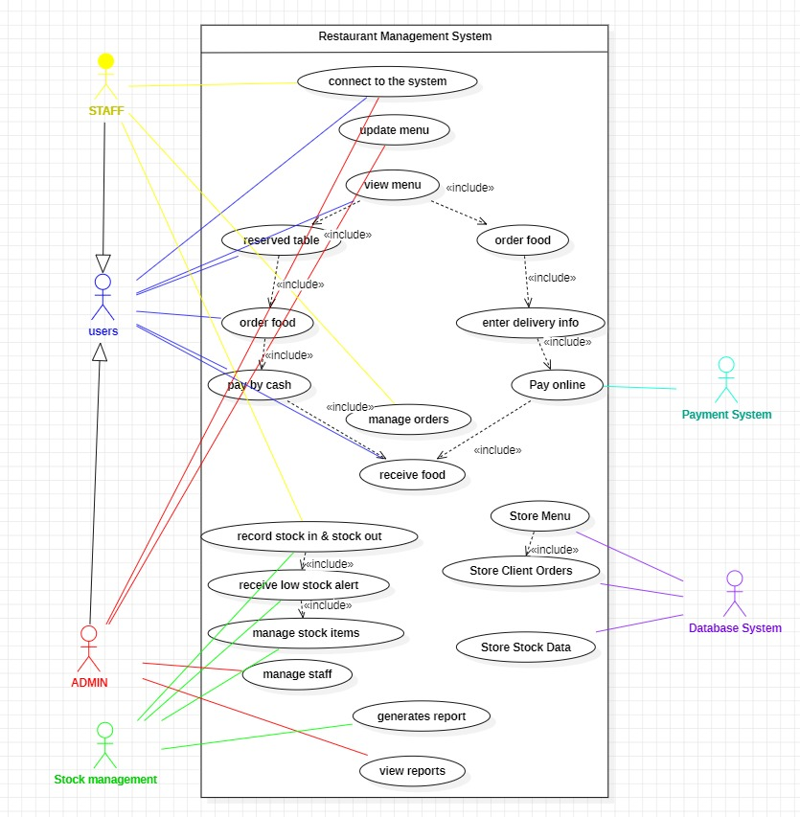
Project Idea
Problem
Restaurants often manage:
Orders manually
Reservations manually
Stock manually
This causes:
Delays
Mistakes
Poor tracking
Solution
A web application to manage restaurant activities digitally.

Slide 3




Technologies Used

Slide 4
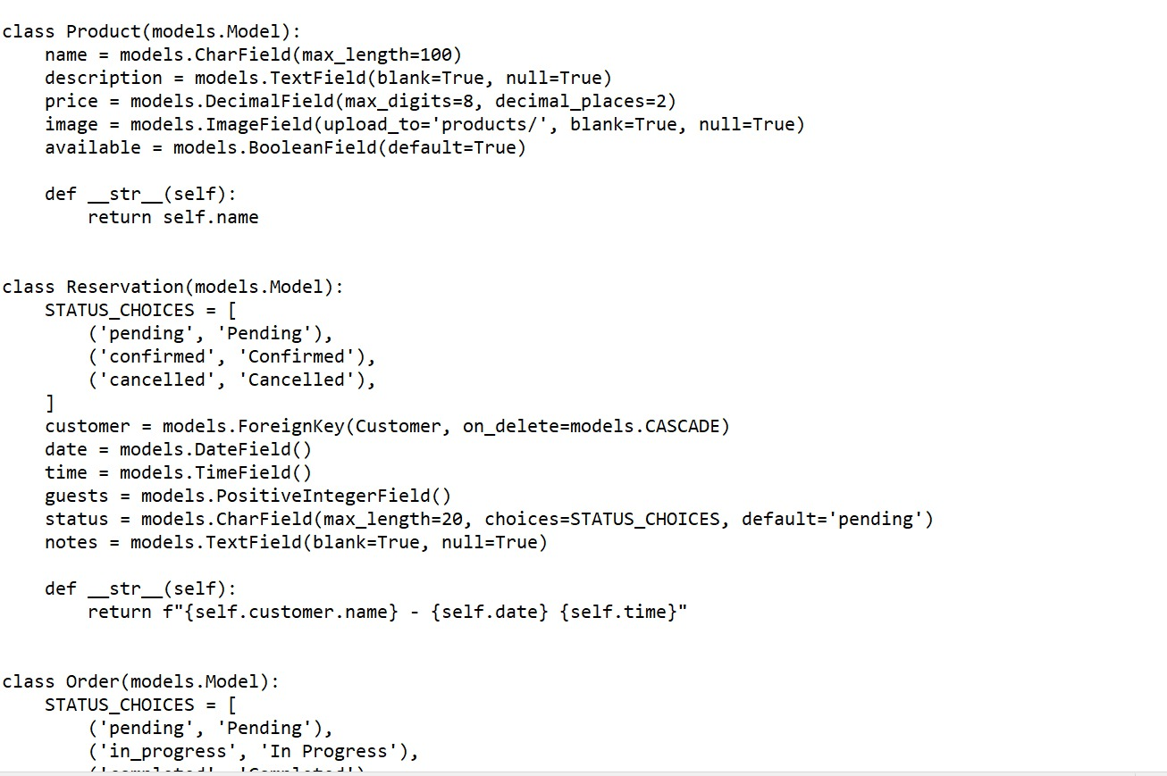
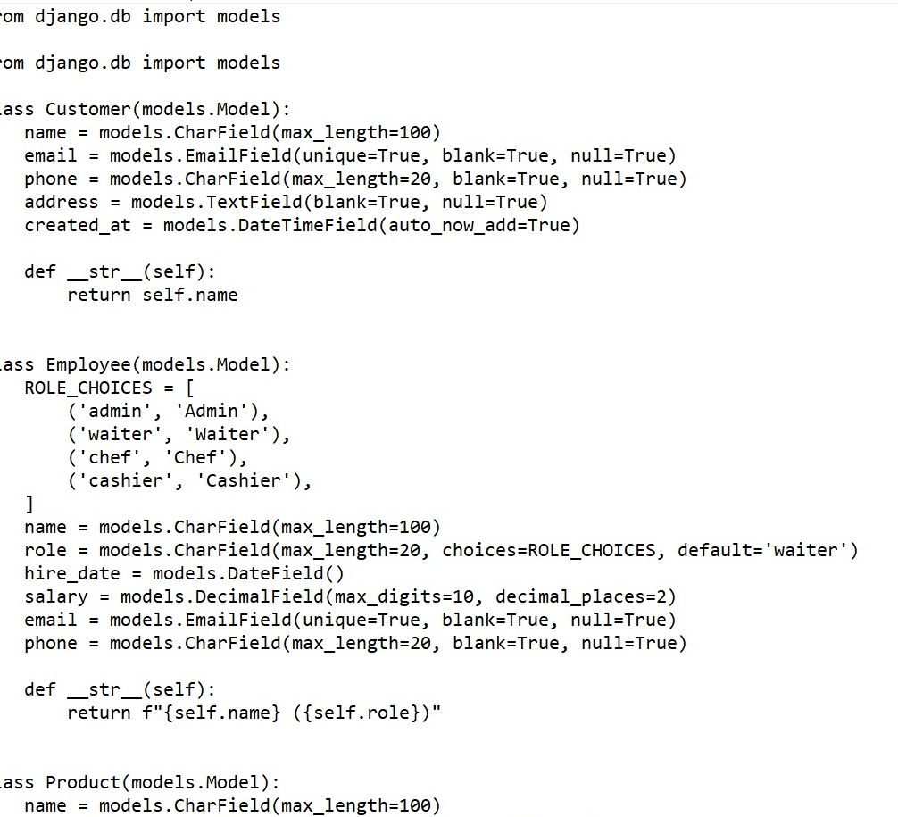
Development Progress
Django project configured
MySQL connected
10 models created
migrations successful
CRUD backend complete
Admin configured

Slide 5
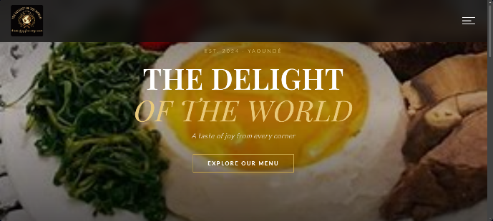
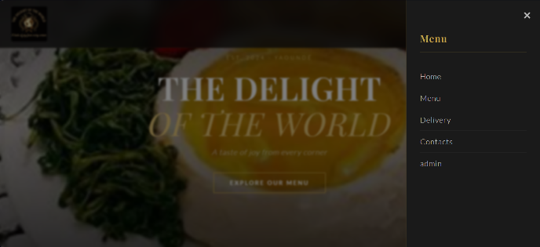
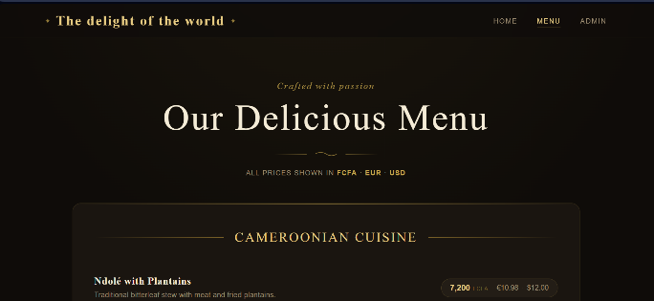
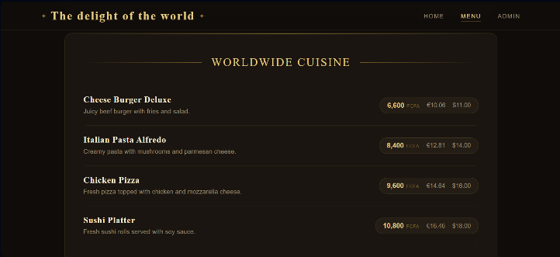
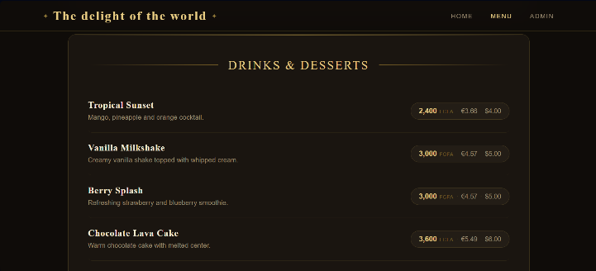
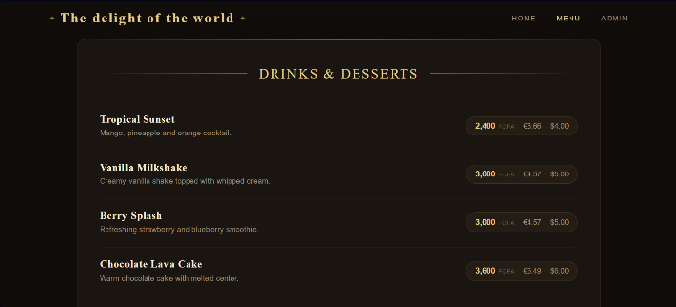
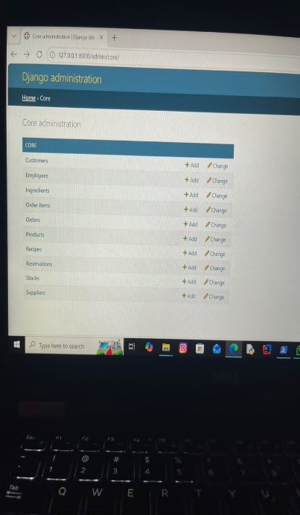
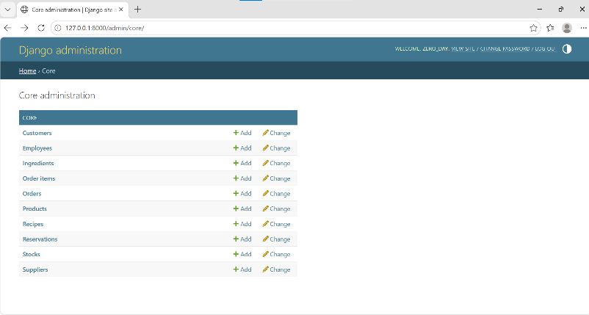
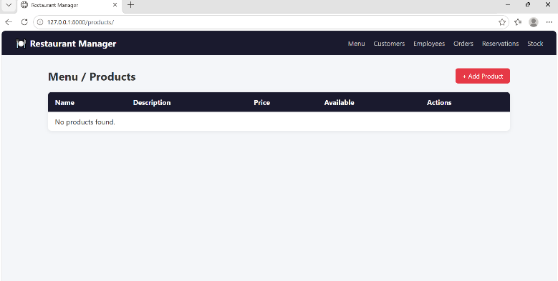
Application Screens
STEP TO GO TO THE MENU
MENU
Admin Interface
Product Lists
Update Interface

Slide 6
Challenges and Future
Challenges
Django setup
Database linking
Team coordination
Future work
Frontend completion
Full testing
Deployment
Final sentence:
The backend system is completed and frontend integration is ongoing.

